Slide 2
Follow me on
AnirudhSir
anirudh15a
@anirudh_23

Slide 4
Which of the statement is correct regarding the dholavira?
1) Dholavira is located in Khadir Island of the Rann of Kutch
2) It is one of the two largest Harappan sites in India
Which of the above statements is/are correct? 1 only 2 only Both 1 and 2 Neither 1 nor 2

Slide 5
World Heritage List for 2020
WHY IN NEWS
Government of India has submitted two nomination dossiers ‘Dholavira: A Harappan City’ and ‘Monuments and Forts of Deccan Sultanate’ for inclusion in the World Heritage List for the year 2020

Slide 6
World Heritage Sites
UNESCO identifies World Heritage sites which must be of outstanding universal value.
It helps in protection and preservation of cultural and natural heritage around the world considered to be of outstanding value to humanity.
It is based on UN’s Convention Concerning the Protection of the World Cultural and Natural Heritage of 1972.
India has 38 World Heritage Sites, including 30 Cultural properties, 7 Natural properties and 1 mixed site.

Slide 7
Dholavira: A Harappan City
Dholavira is located in Khadir Island of the Rann of Kutch, Gujarat
It is a fortified quadrangular Harrapan city set which saw occupation for 1200 years (3000 BCE-1800 BCE)
It is one of the two largest Harappan sites in India, and 5th largest in the subcontinent.
It lay between two seasonal streams, the Mansar in the north and Manhar in the south

Slide 8
The site demonstrates the ingenuity of Harappan people to evolve a highly organised system of town planning with perfected proportions, interrelation of functional areas, street-pattern and an efficient water conservation system.
It adopted excellent water conservation strategy by building dams, reservoirs and pipelines.
The site has three distinct zone comprising of a distinct upper (citadel, bailey) and middle (having a distinct street-pattern, large scale enclosure and a ceremonial ground) towns enclosed by a lower town (with narrower streets, smaller enclosures and industrial area.

Slide 9
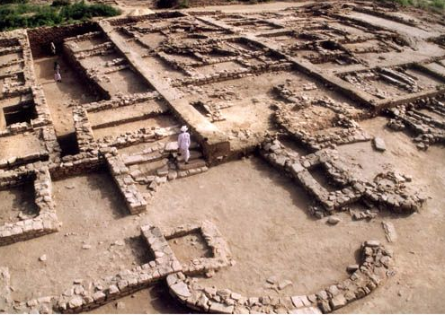
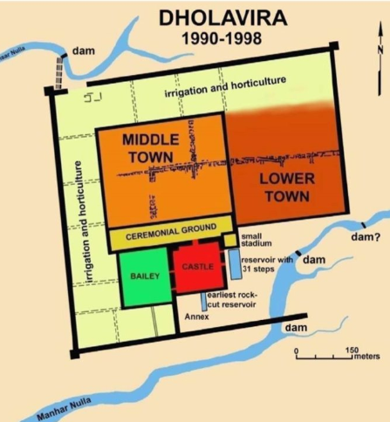

Slide 10
Monuments and Forts of Deccan Sultanate
It includes Indo Islamic monuments at 4 sites in Gulbarga, Bidar, Bijapur and Hyderabad
Bahmani Monuments at Gulbarga, Karnataka
Bahmani and Barid Shahi Monuments at Bidar, Karnataka
Adil Shashi Monuments at Bijapur, Karnataka
Qutb Shahi Monuments at Hyderabad, Telengana

Slide 11
Bahmani Monuments at Gulbarga and Bidar
Bahmani Monuments at Gulbarga, Karnataka :
These monuments were built in 14th century and primarily comprise of:
The Gulbarga Fort and Great Mosque in the Fort
The Haft Gumbad complex with seven tombs
Bahmani and Barid Shahi Monuments at Bidar, Karnataka
These were built from late 15th to the early 16th centuries and comprise of Bidar Fort, Madrasa Mahmud Gawan, Bahamani tombs at Ashtur and Barid Shahi tombs

Slide 12
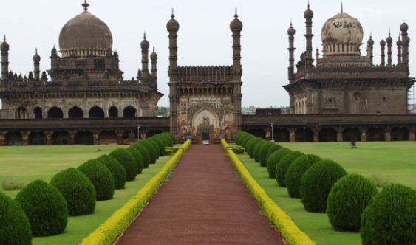
Adil Shashi Monuments at Bijapur, Karnataka
The Adil Shahi monuments at Bijapur date from late 15th to the late 17th centuries.
These are an ensemble of 80 small and big monuments including the fortifications, gates, water systems and tanks, several mosques and tombs and palatial structures.
The most remarkable monuments within the fort is Gol Gumbaz that is the 2nd largest dome in world and is the tomb of Muhammad Adil Shah.

Slide 13
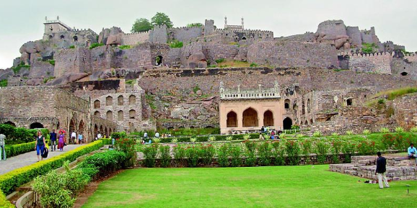
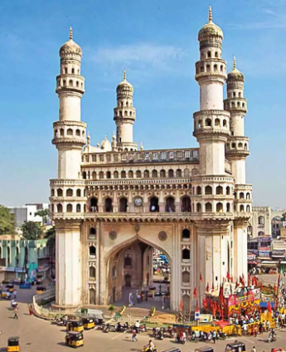
Qutb Shahi Monuments at Hyderabad, Telengana
The landmarks that symbolize the Qutb Shahi Dynasty are Golconda Fort, Qutb Shahi Tombs and Charminar.
Charminar is a ceremonial Gateway built to celebrate the foundation of Hyderabad in 1591 A.D.

Slide 14
CHARDHAM PARIYOJANA
WHY IN NEWS
Recently, 440 metre-long tunnel under Chardham Pariyojana was inaugurated in Chamba.

Slide 15
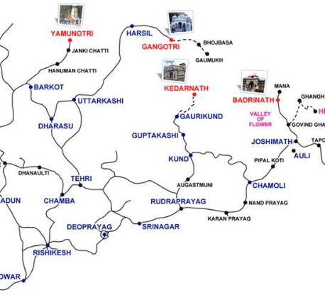
This initiative was taken up by Ministry of Road Transport and Highways for connectivity Improvement for Char-Dham (Kedarnath, Badrinath, Yamunothri & Gangothri) in Uttarakhand.
It also gives Connectivity to the India-China border.

Slide 16
Which of the statement is correct regarding the Konark Sun Temple?
1) It was built middle of 8th century, by King Narasimhadeva I of Ganga dynasty
2) It is UNESCO world heritage site.
Which of the above statements is/are correct? 1 only 2 only Both 1 and 2 Neither 1 nor 2

Slide 17
KONARK SUN TEMPLE
WHY IN NEWS
The central government has launched a program for the solarization of Odisha’s Konark Sun Temple and the surrounding Konark town.

Slide 18
Sun Temple, Konark
It was built middle of 13th century, by King Narasimhadeva I of Ganga dynasty.
Temple is representation of sun god Surya's chariot with 24 wheels.
It is UNESCO world heritage site.
It is also known as 'Black Pagoda' due to its dark color.
Ministry of New and Renewable Energy has taken up the Complete Solarisation of Konark sun temple and Konark town in Odisha to develop it as ‘Surya Nagri’.

Slide 19
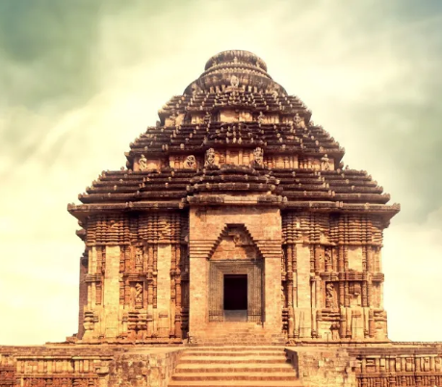
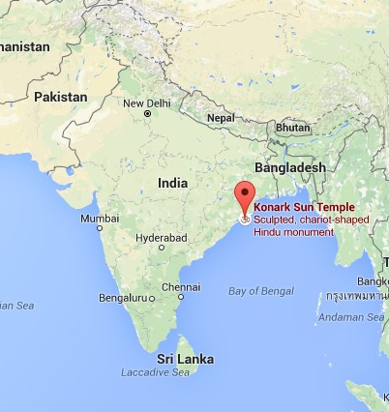

Slide 20
Florence Nightingale
WHY IN NEWS
200th birth anniversary of Florence Nightingale, founder of modern nursing was celebrated on May 12.

Slide 21
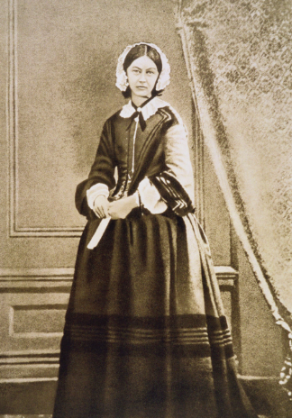
Florence Nightingale (1820-1910)
Florence Nightingale (1820-1910) also known as “The Lady with the Lamp” was a British nurse, social reformer and statistician best known as the founder of modern nursing.
She established St. Thomas’ Hospital, London and the Nightingale Training School for Nurses in 1860.
She is credited with being the first healthcare professional to use data to show that infections control improves health outcomes.

Slide 22
Through her career she stressed on practice of handwashing that is relevant as ever today
She was instrumental in setting up training for midwives and nurses in workhouse infirmaries.
The International Nurses Day is observed annually on May 12 commemorating her birth and celebrates the important role of nurses in health care.
World Health Organization (WHO) has designated 2020 as the “International Year of the Nurse and the Midwife,” in honor of the 200th anniversary of Florence Nightingale's birth.

Slide 23
Stay Tuned…
Subscribe to Study IQ
@anirudh_23

